Slide 1






2025 SPARK ACADEMY
TRAIN FOR CHANGE, FROM SCIENCE TO PRACTICE
THE SPRINT AI TRAINING FOR AFRICAN MEDICAL
Imaging Knowledge Translation (SPARK)
Academy
IN DEEP LEARNING & MEDICAL IMAGING
Version Control and Collaboration: Git, GitHub & GitHub Classroom
22nd fed, 2025

Slide 2
Outline
Understanding Git: A Version Control System
Setting Up a Git Repository
Exploring the Git Workflow
Essential Git Commands for Beginners
Working with Branches: Creation and Navigation
GitHub and Its Key Features (Repositories)
Syncing Changes: Fetch, Pull, and Push
https://event.fourwaves.com/spark

Slide 3
Version Control system
A Version Control System (VCS) is a tool that helps manage and track changes to files and directories over time. It allows you to:
Track changes made to files throughout development.
Recall and restore previous versions when needed.
Collaborate efficiently by managing contributions from multiple people.
Maintain a history of modifications for auditing and troubleshooting.
https://event.fourwaves.com/spark

Slide 4

Git
Git Blame or Git commit
https://event.fourwaves.com/spark

Slide 5
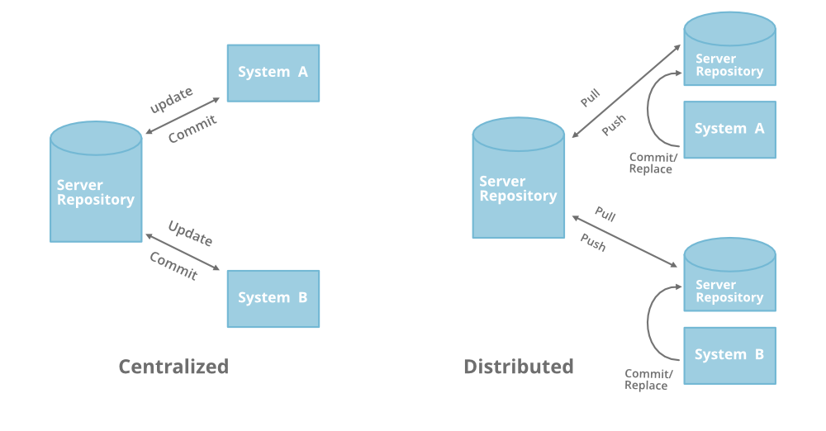
Distributed version control
No central server—every copy of the repository is complete.
Every developer acts as a client, server, and repository simultaneously.
Enables offline work and faster operations compared to centralized version control.
Improves collaboration and redundancy, reducing the risk of data loss.
https://event.fourwaves.com/spark

Slide 6
Git as a Distributed version control
No need for a central server – every copy is a full repository.
Works offline – no internet connection required for local changes.
No single point of failure—every developer has a complete history.
Developers work independently and merge changes later.
Every repository can act as both server and client with full version history.
Tracks changes, not versions—stores changes as snapshots rather than full copies.
Uses a series of small change sets that can be combined and shared.
https://event.fourwaves.com/spark

Slide 7
Setting up Git: Configure your identity
Setup your name and email so others can know who committed changes.
Global configuration (for all repositories on your system):
git config --global user.name "Your Name"
git config --global user.email "your.email@example.com"
Local configuration (for a specific repository):
git config --local user.email "your.email@example.com"
Note: can set differently for each repository
https://event.fourwaves.com/spark

Slide 8
Essential Git commands
Initializing a repository (git init)
Checking repository status (git status)
Adding files to staging (git add)
Committing changes (git commit -m "message")
Viewing commit history (git log)
Removing and renaming files (git rm, git mv)
https://event.fourwaves.com/spark

Slide 9
Branches in git
Why Use Branches in Git?
Experiment with new ideas without affecting the main codebase.
Easily discard failed attempts by deleting the branch instead of undoing multiple changes in the main branch.
Merge successful ideas into the main (master/main) branch when ready.
Note: There is only one working directory, even when switching between branches.
https://event.fourwaves.com/spark

Slide 10
github
A cloud-based platform for hosting Git repositories.
🌐 Website: https://github.com/
Launched in 2007, now the most popular Git hosting service.
Enables collaboration from anywhere in the world.
Makes Git social! – Developers can share, review, and contribute to code easily.
Free to start with options to pay for private repositories and advanced features.
https://event.fourwaves.com/spark

Slide 11
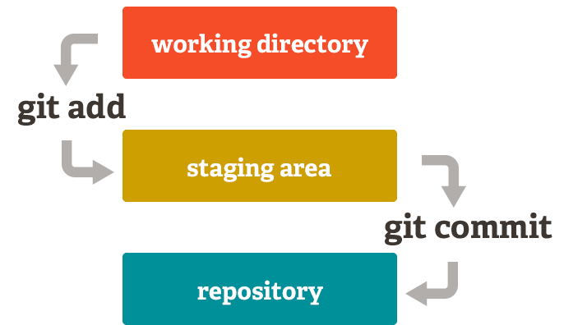
git’s three-tree architecture
Working Directory – Contains the current state of files being edited.
Staging Area (Index) – Holds changes that are marked for the next commit.
Repository (HEAD) – Stores committed changes permanently.
https://event.fourwaves.com/spark

Slide 12
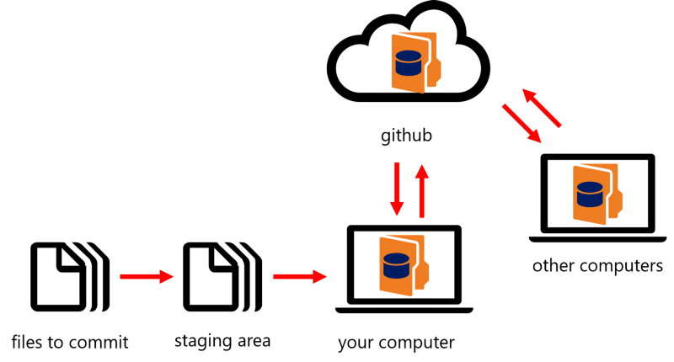
git’s workflow
https://event.fourwaves.com/spark

Slide 13
Demo
Git
GitHub
GitHub Classroom
https://event.fourwaves.com/spark

Slide 14
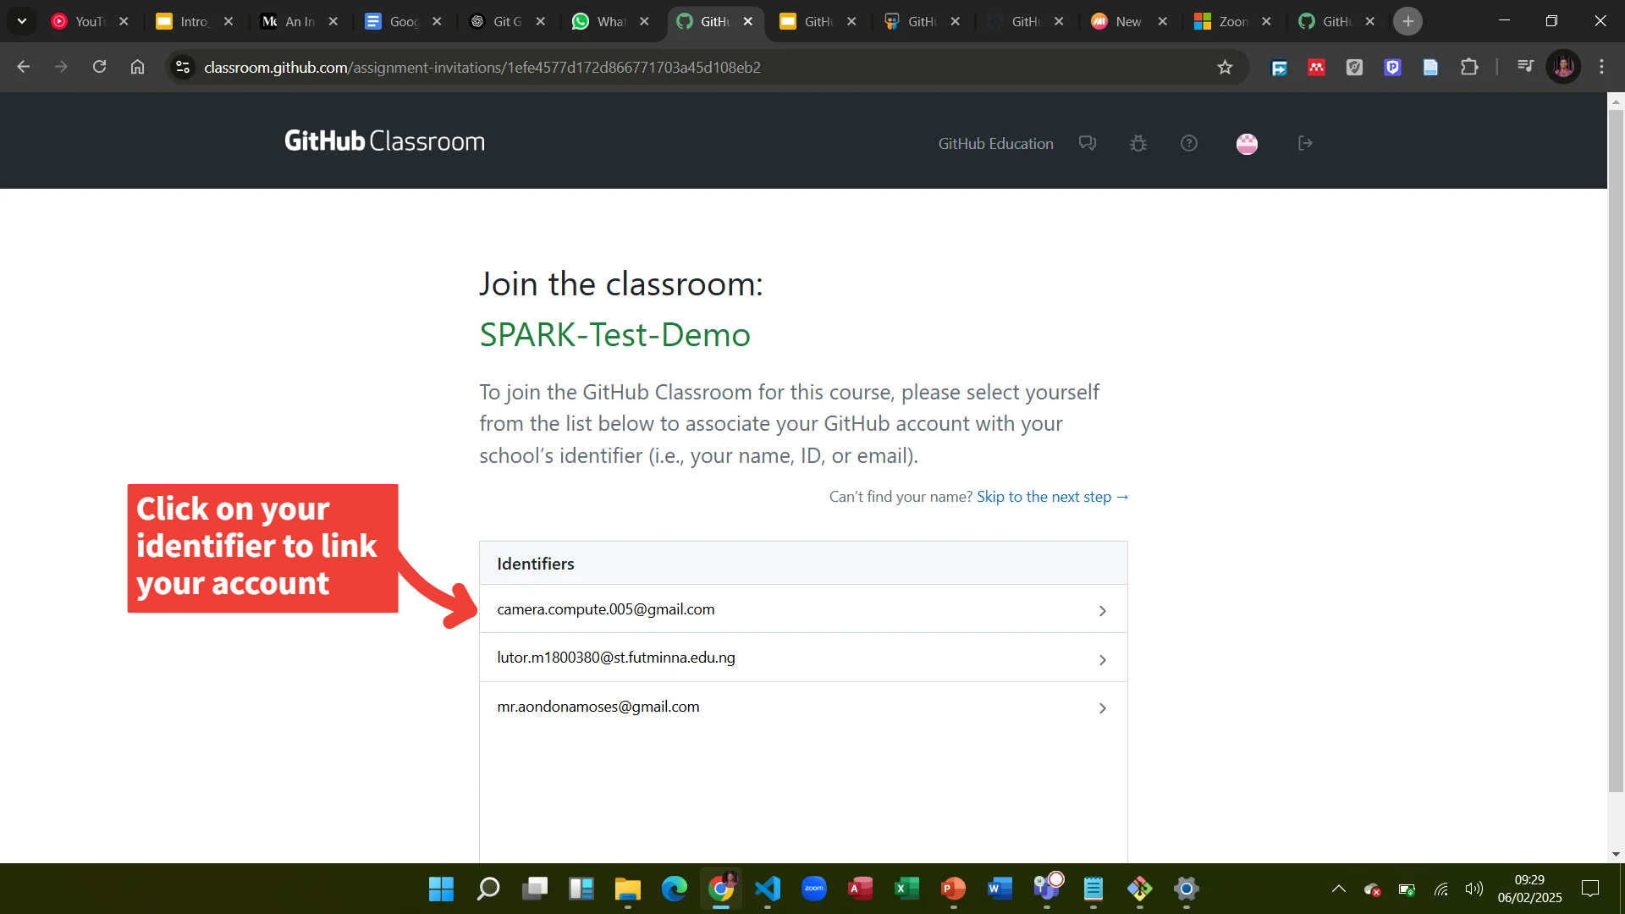
Github Classroom
https://event.fourwaves.com/spark

Slide 15
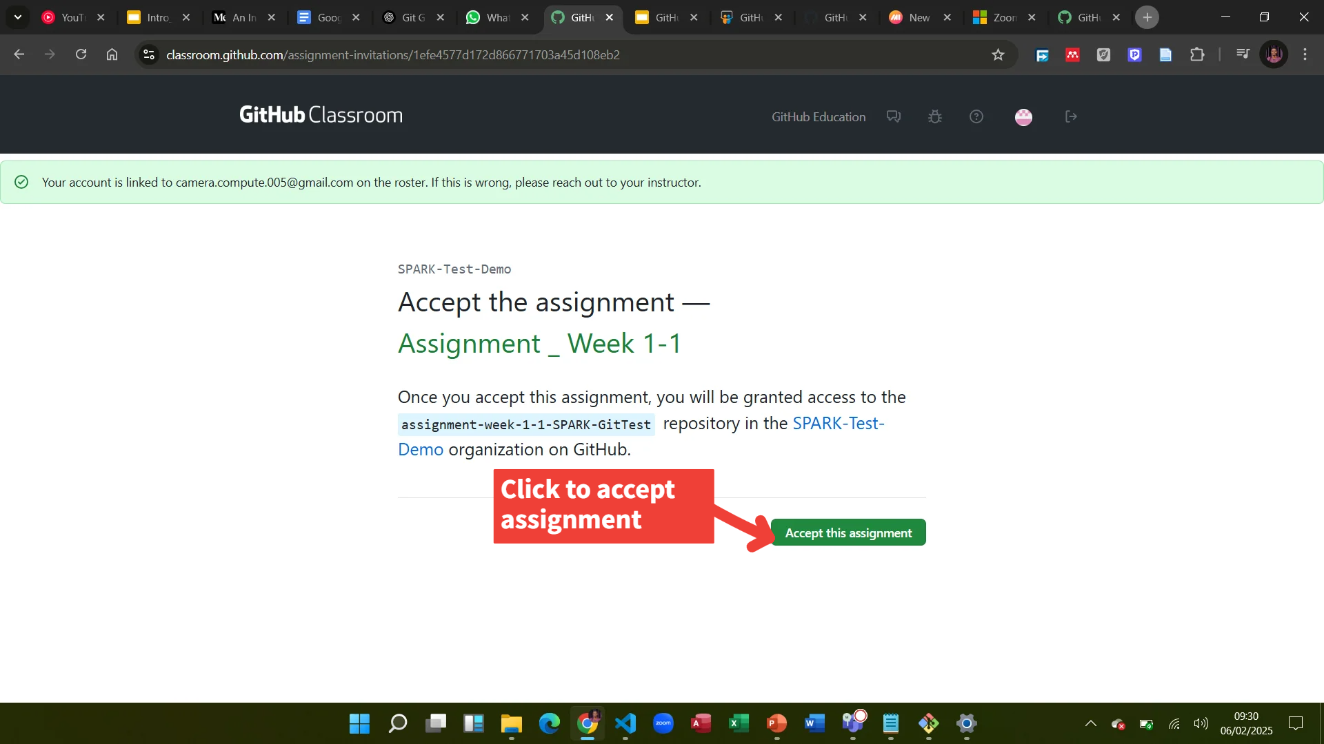
Github Classroom
https://event.fourwaves.com/spark

Slide 16
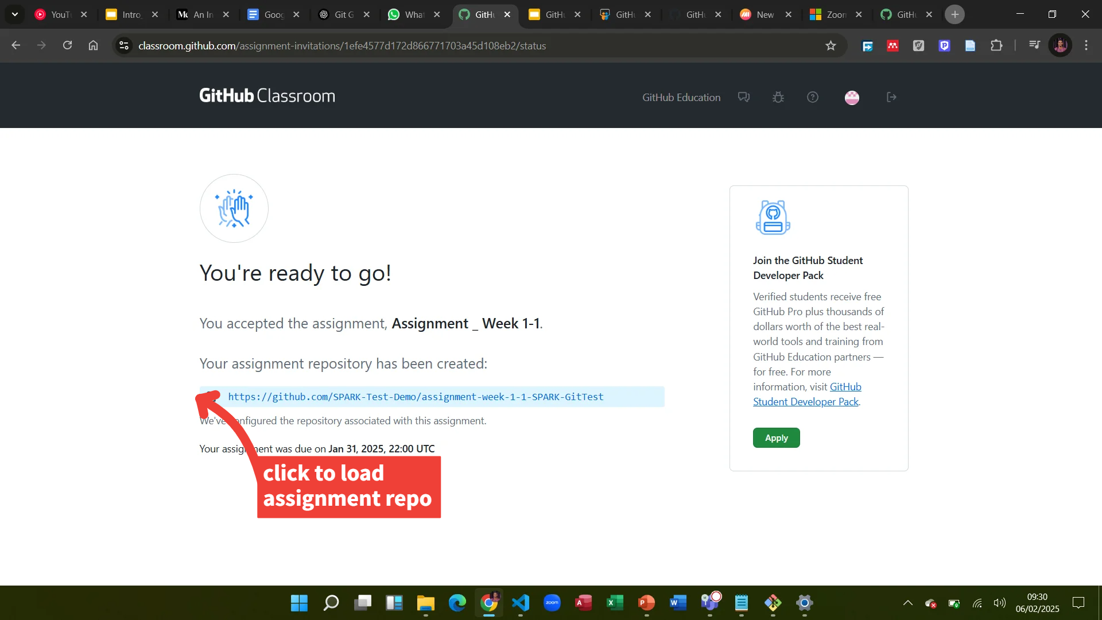
Github Classroom
https://event.fourwaves.com/spark

Slide 17
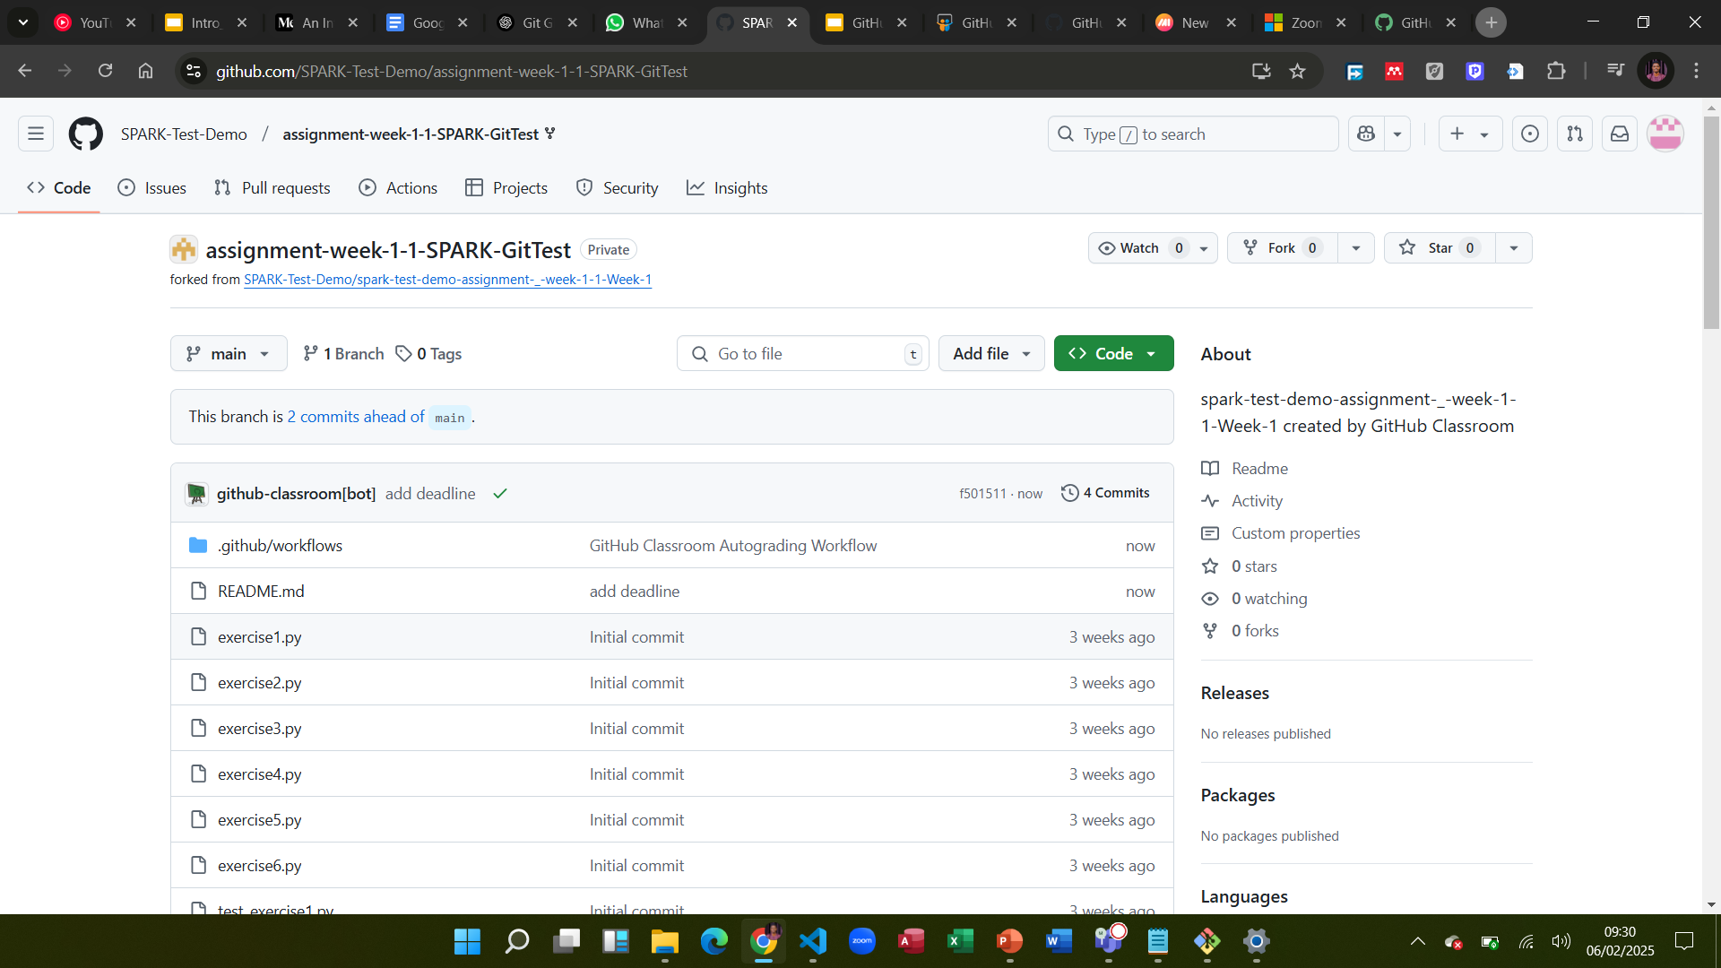
Github Classroom
https://event.fourwaves.com/spark

Slide 18
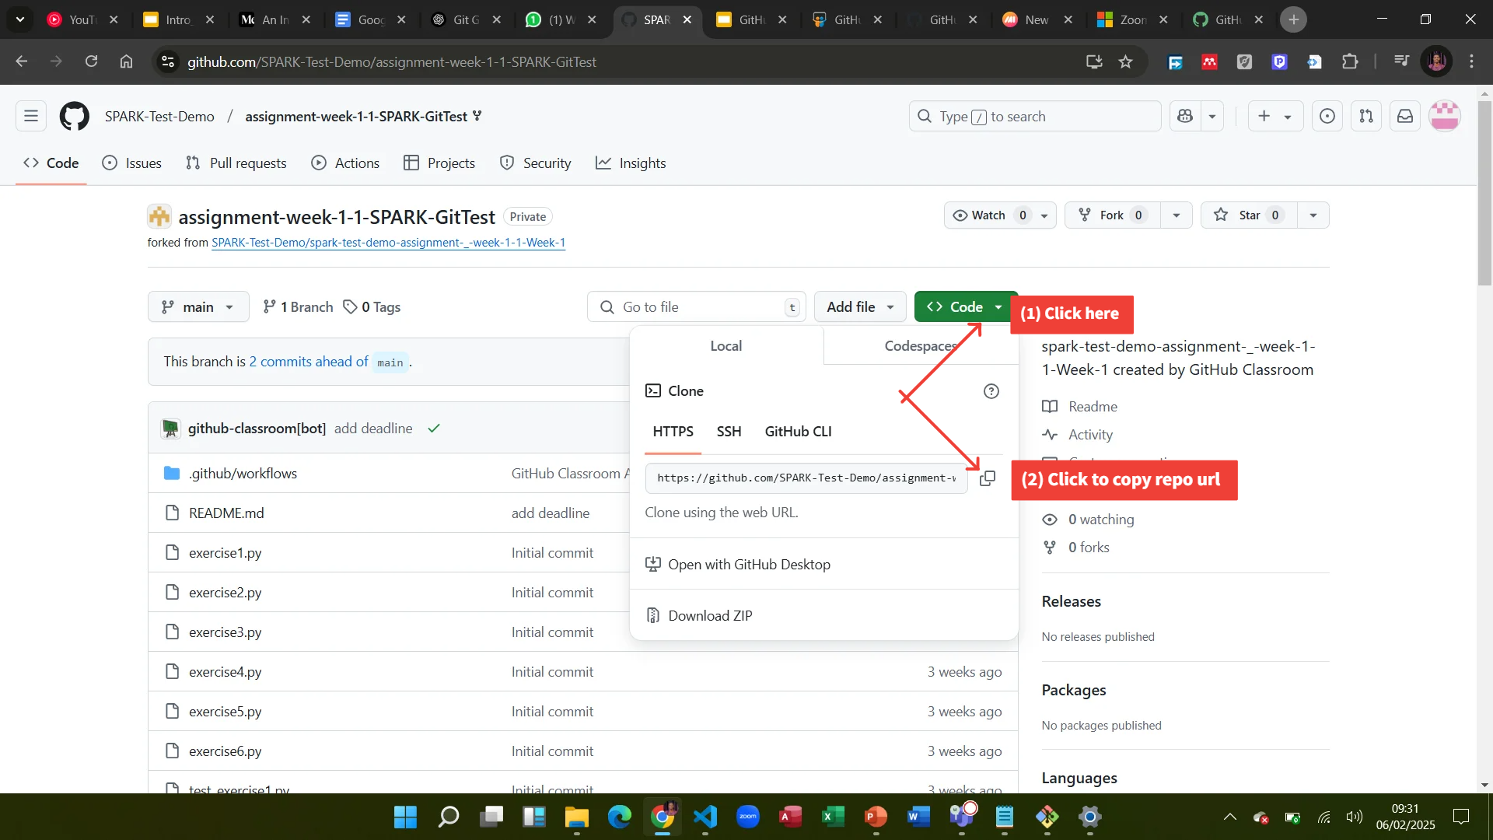
Github Classroom
https://event.fourwaves.com/spark

Slide 19
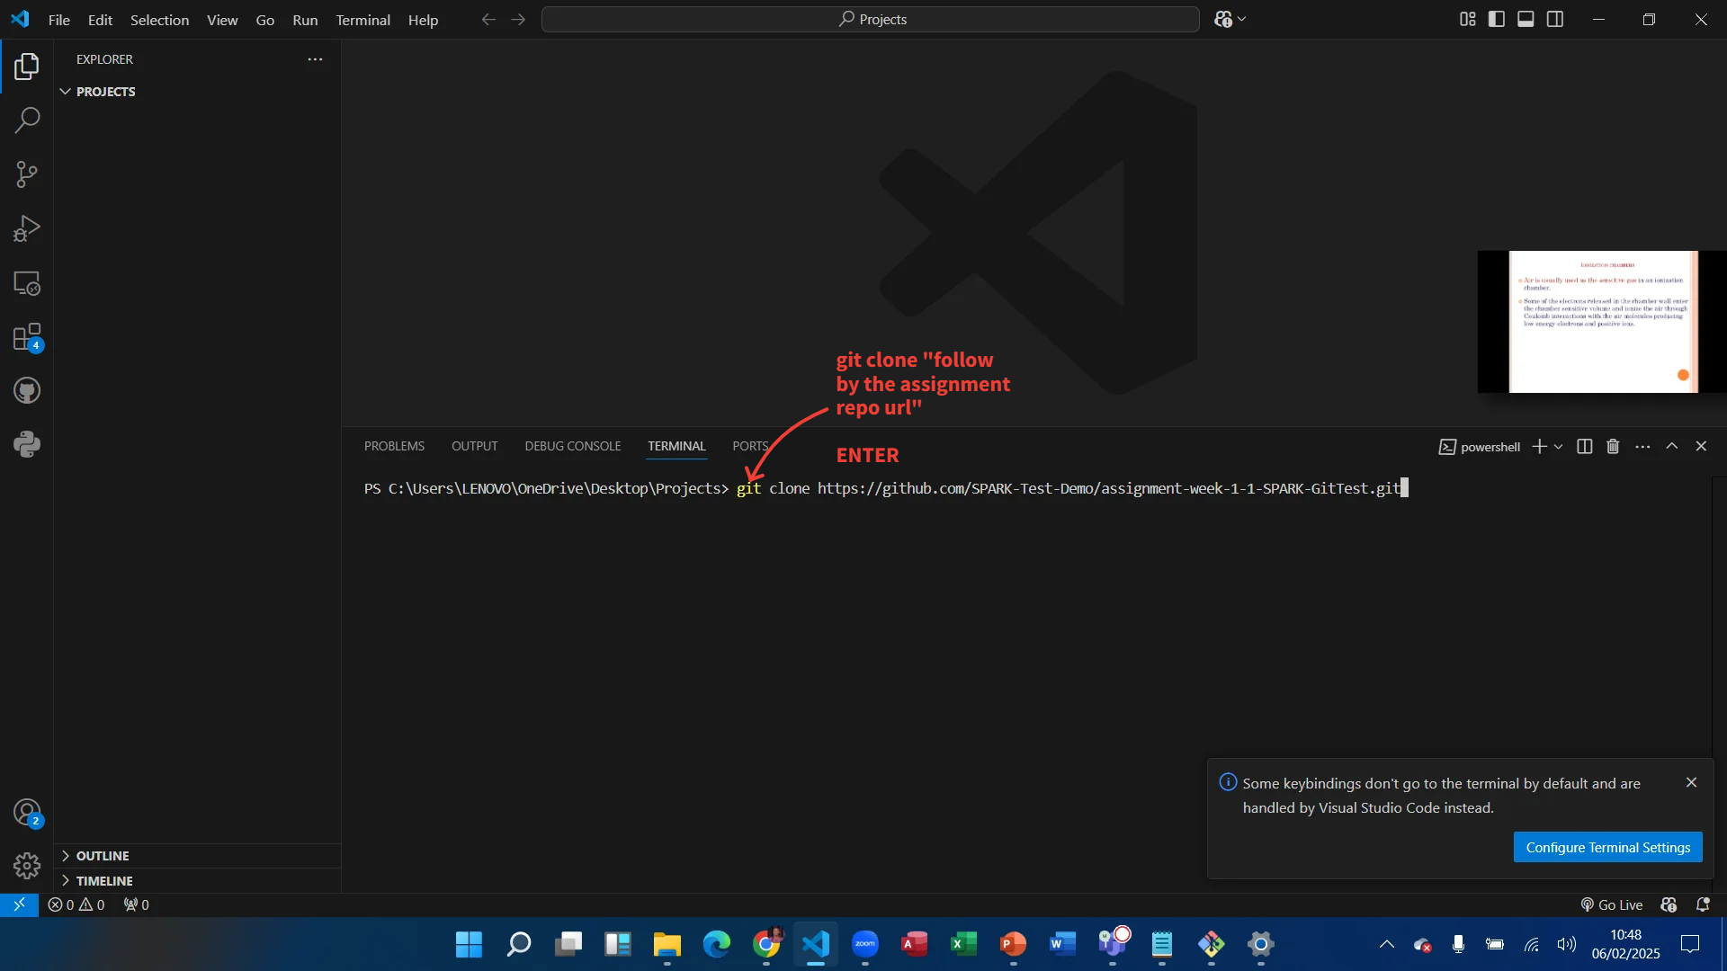
Github Classroom
https://event.fourwaves.com/spark

Slide 20
2025 SPARK ACADEMY
TRAIN FOR CHANGE, FROM SCIENCE TO PRACTICE
Thank you
&
Welcome to SPARK
ENJOY CODING & MEDICAL IMAGING

